Slide 1
Bioinformatics for RNA-seq
Wenwen Hou
Rebecca Batorsky
Albert Tai
May 2020
Notes:
Notes on programming language - prereqs

Slide 2
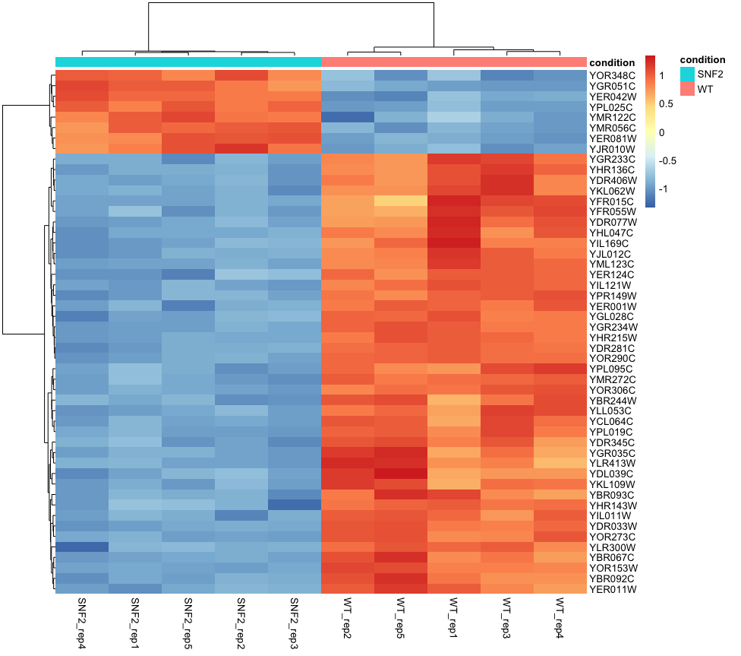
Common RNAseq analysis goals
Novel transcript discovery
Transcriptome assembly
Single cell analysis
Quantify alternative splicing
Differential Expression

Slide 3
Why is differential expression useful?
We’re looking for an explanation of observed phenotypes:
YPG
YPG + vitamin C
Wild Type
Mutant
What causes difference in phenotype?
Difference in protein activity!

Slide 4
mRNA is easier to measure than protein, so we use it as a proxy
Gene A
Gene B
Gene C
Read Counts
Number of mRNA copies
Concentration of proteins
Difference in protein activity
Phenotype
https://www.slideshare.net/jakonix/part-1-of-rnaseq-for-de-defining-the-goal

Slide 5
Though our assumptions about correlation are often violated
Gene A
Gene B
Gene C
Read Counts
Failure to map to proper location, biases in library prep
Number of mRNA copies
mRNA templates have different speeds of protein production, alternative splicing
Concentration of proteins
Protein activity is independently regulated (phosphorylation, ubiquitination)
Difference in protein activity
Phenotype
https://www.slideshare.net/jakonix/part-1-of-rnaseq-for-de-defining-the-goal

Slide 6
As a consequence, we look at comparisons
Gene A
Gene B
Gene C
Gene A
Gene B
Gene C
Read Counts
Read Counts
Number of mRNA copies
Number of mRNA copies
Concentration of proteins
Concentration of proteins
Difference in protein activity
Difference in protein activity
WT Phenotype
Mutant Phenotype

Slide 7
Our goal
“How can we detect genes for which the counts of reads change between conditions more systematically than as expected by chance”
We must design an experiment where this hypothesis can be tested.
Oshlack et al. 2010. From RNA-seq reads to differential expression results. Genome Biology 2010, 11:220 http://genomebiology.com/2010/11/12/220

Slide 8
Experiment design
How deep to sequence?
How many biological replicates to choose?
Difficult to answer in general but certainly >=3 replicates and ~20 M reads/replicate for strongly expressed genes
Pilot studies are recommended to determine the number of replicates needed to capture the variability (e.g. 2 bio replicates, 10-20 M reads)

Slide 9
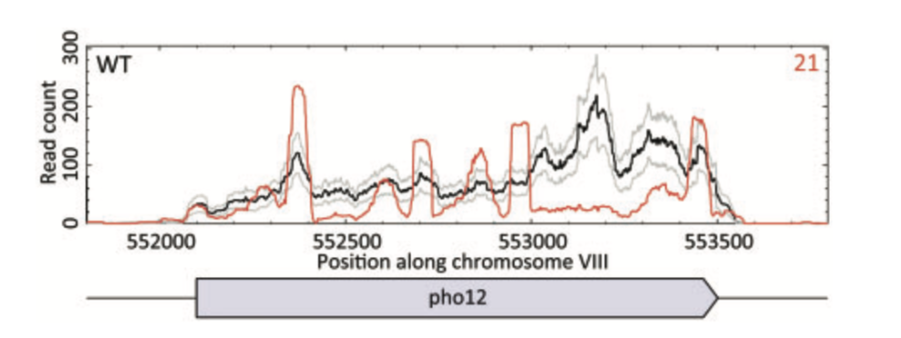
Invest in replicates!
The most effective way to improve detection of differential expression in low expression genes is to add more replicates, rather than adding more reads
The following figure from Gierlinski et al shows coverage variation in 4 replicates of a relatively simple yeast transcriptome
The paper concludes that we should invest in 6 biological replicates per condition

Slide 10
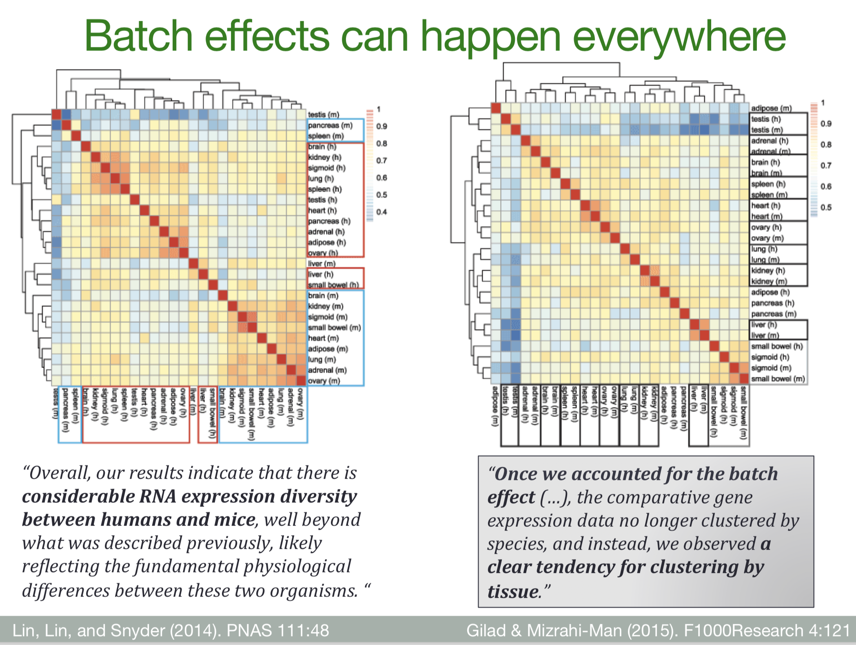
Credit: http://chagall.med.cornell.edu/RNASEQcourse/

Slide 11
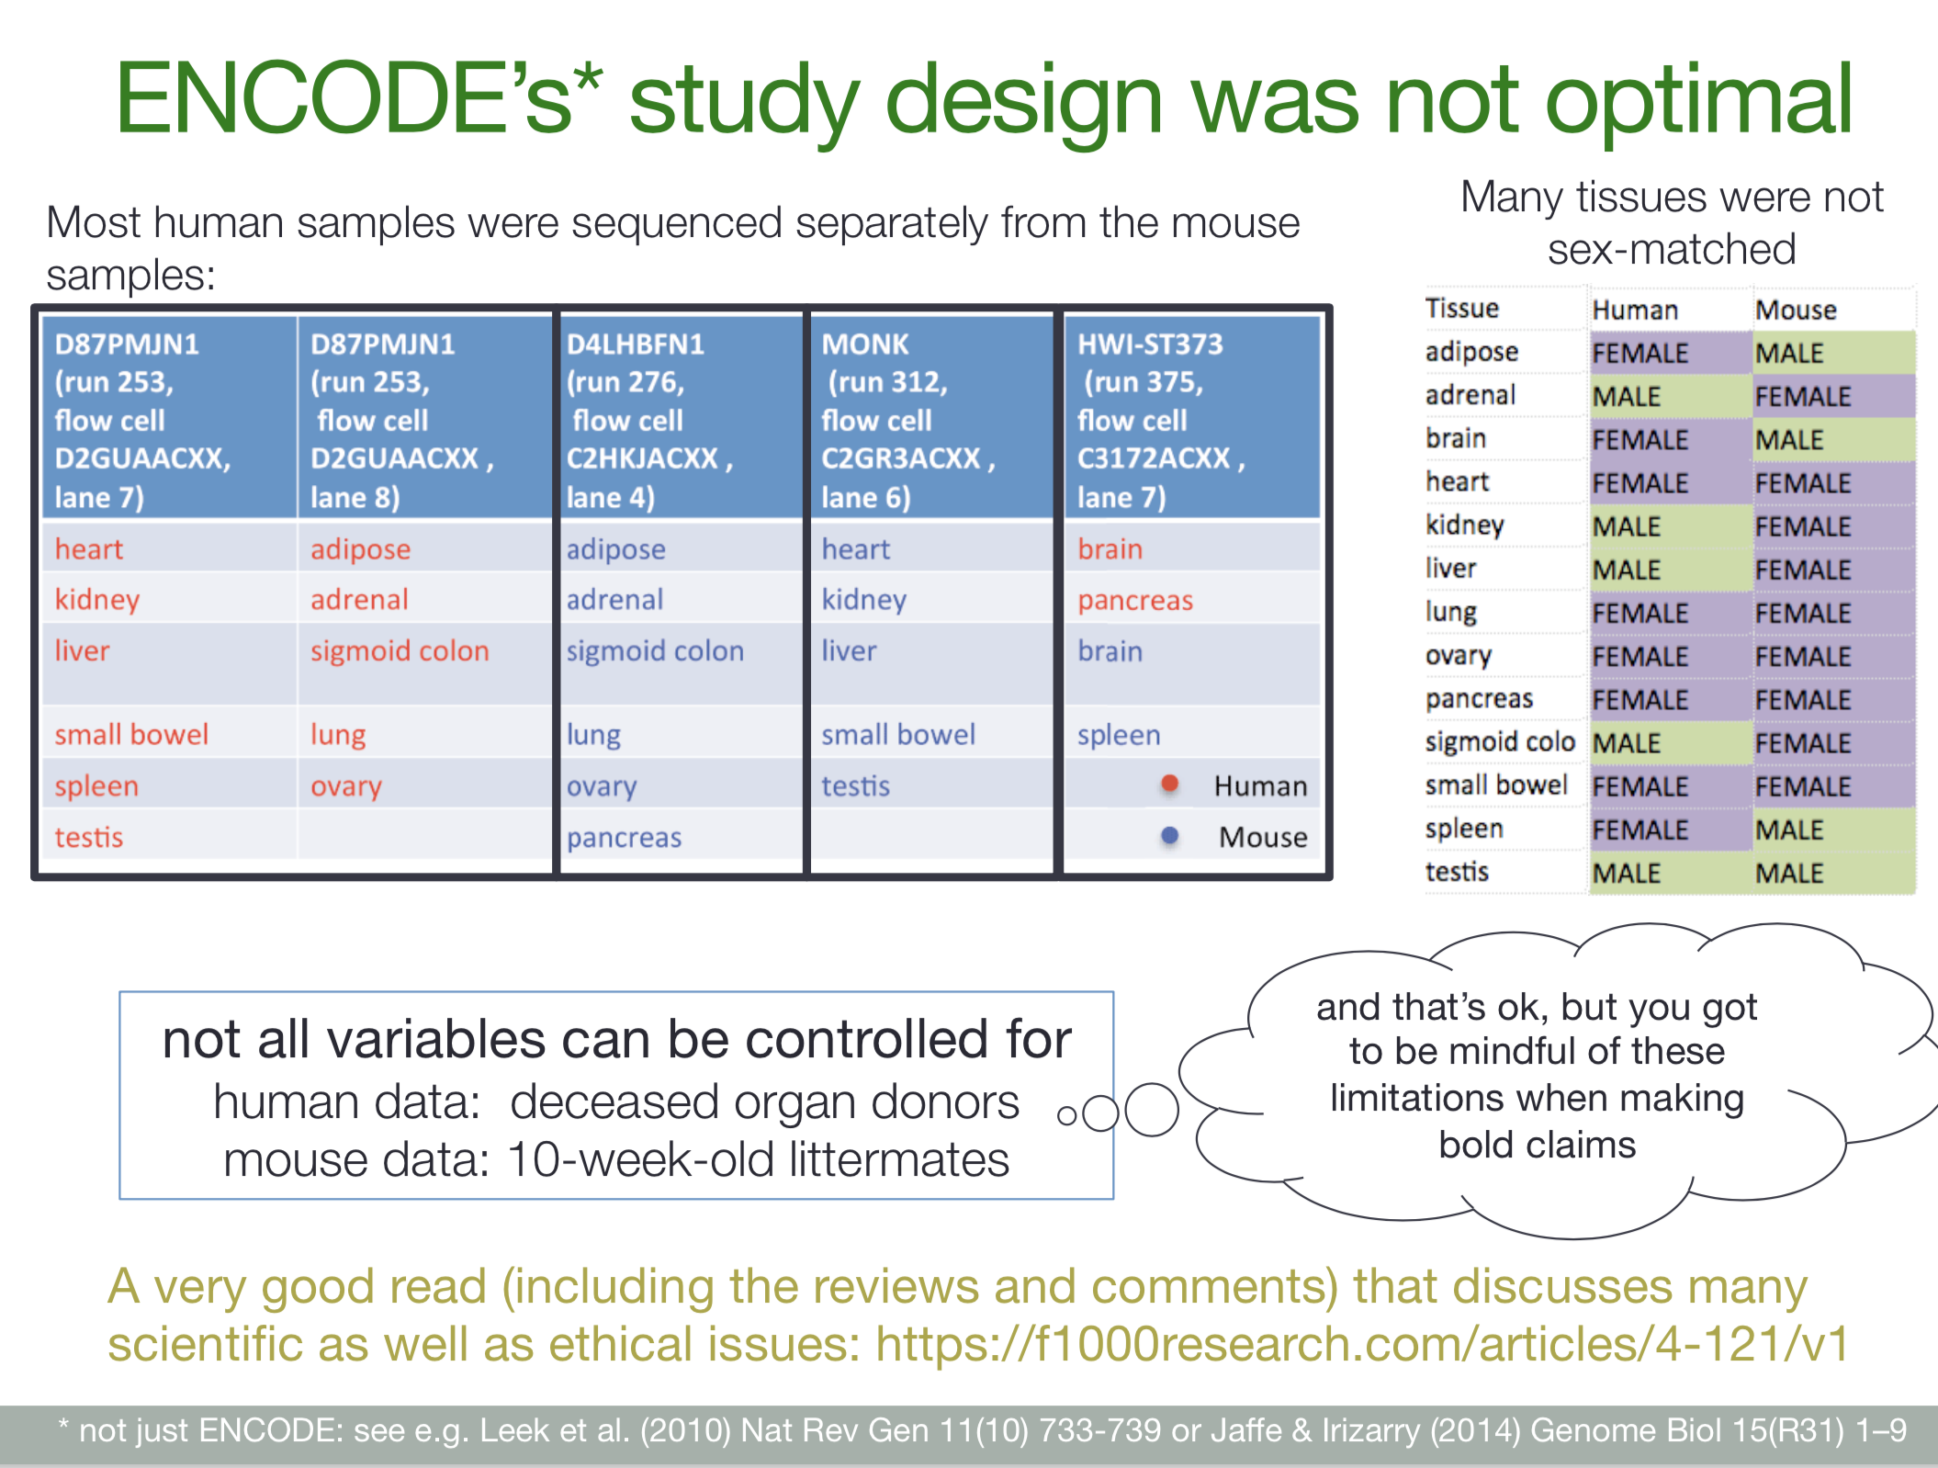

Slide 12
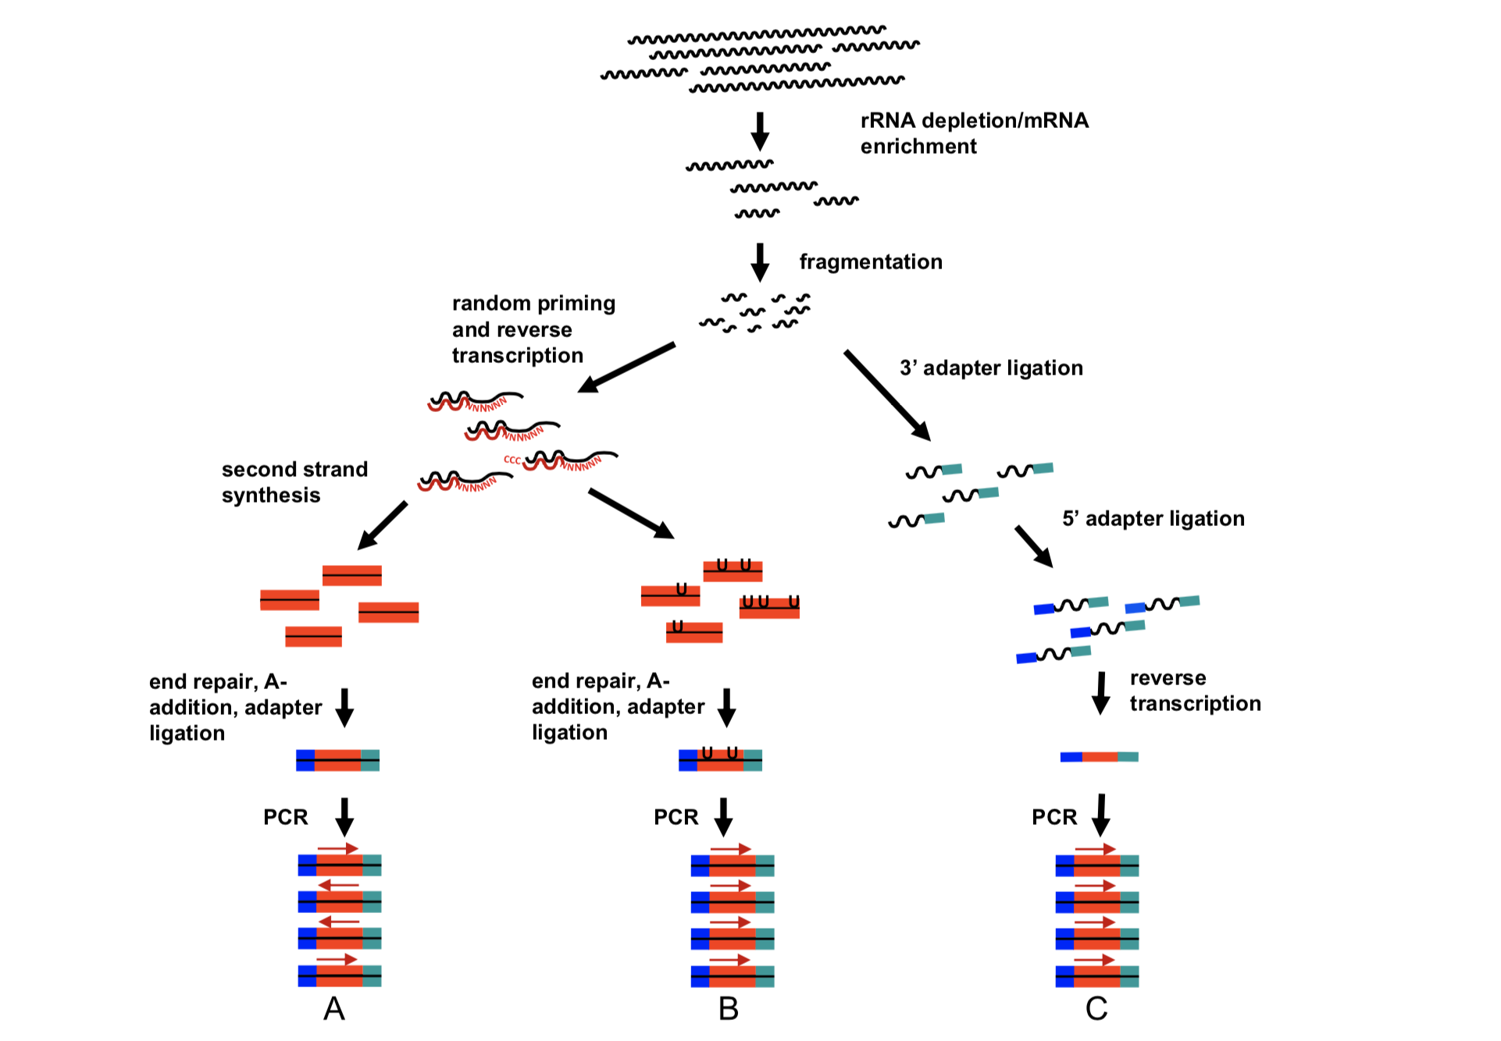
Classic Illumina RNAseq Library Preparation
RNA extraction
mRNA enrichment
Fragmentation ~200 bp
Random priming + reverse transcription
Double stranded cDNA synthesis
Sequencing adapter ligation
PCR
Van Dijk et al. Experimental Cell Research 2014

Slide 13
Classic Illumina RNAseq Library Preparation
RNA extraction
mRNA enrichment
Fragmentation ~200 bp
Random priming + reverse transcription
Double stranded cDNA synthesis
See reference for protocols that preserve the strand information
Sequencing adapter ligation
PCR
Van Dijk et al.Experimental Cell Research 2014

Slide 14
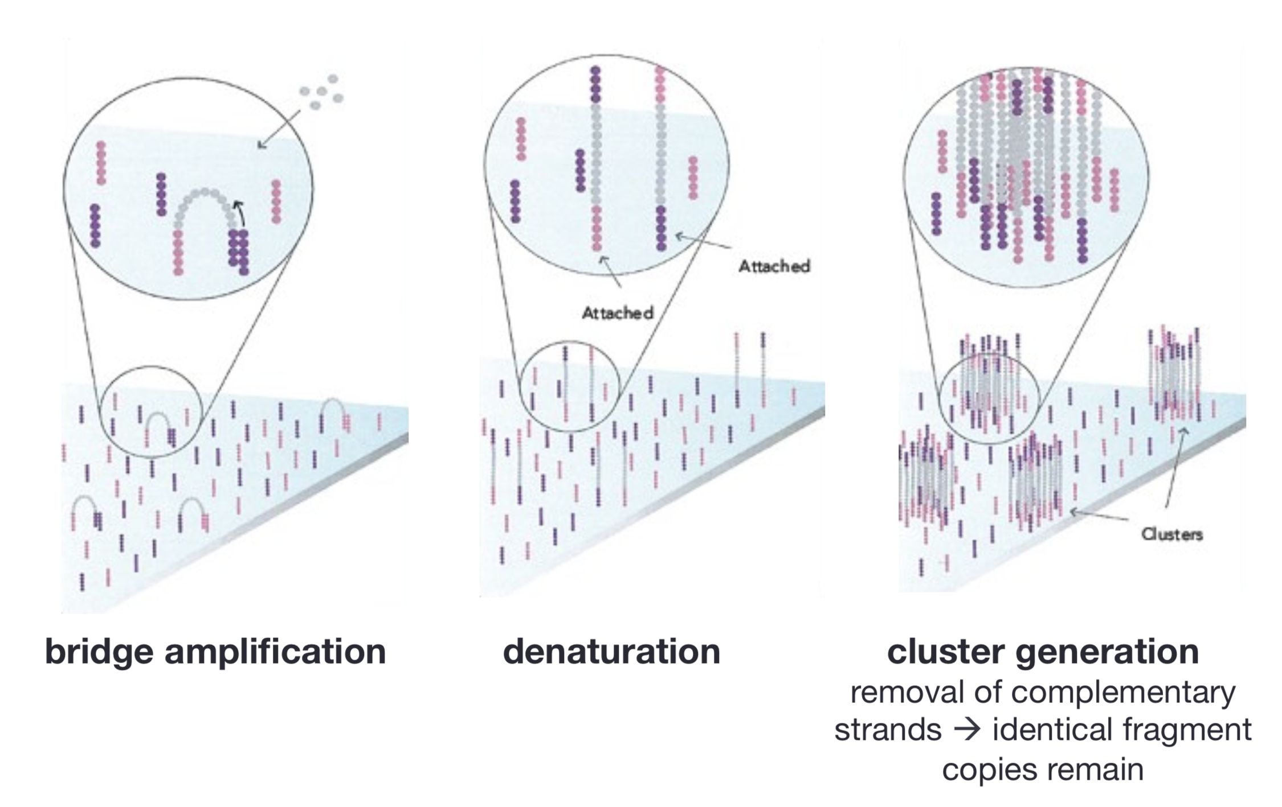
Illumina Sequencing

Slide 15
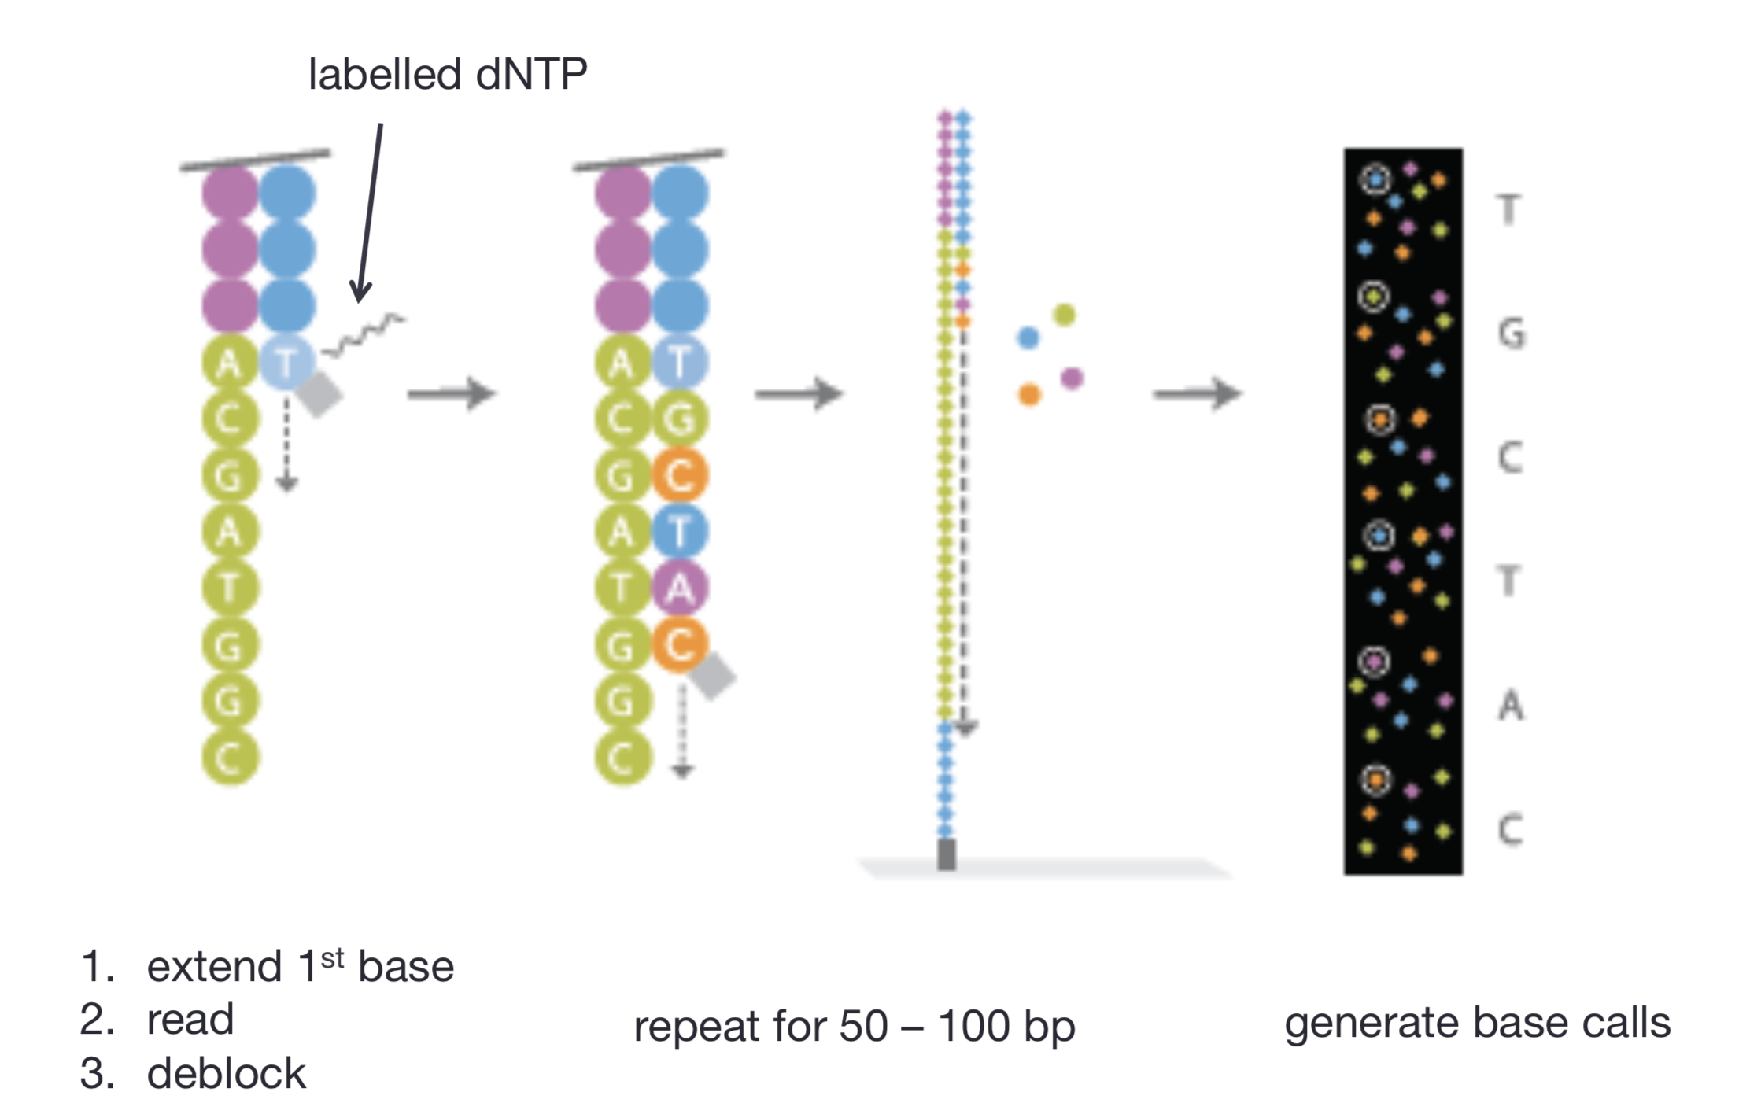
Illumina Sequencing

Slide 16
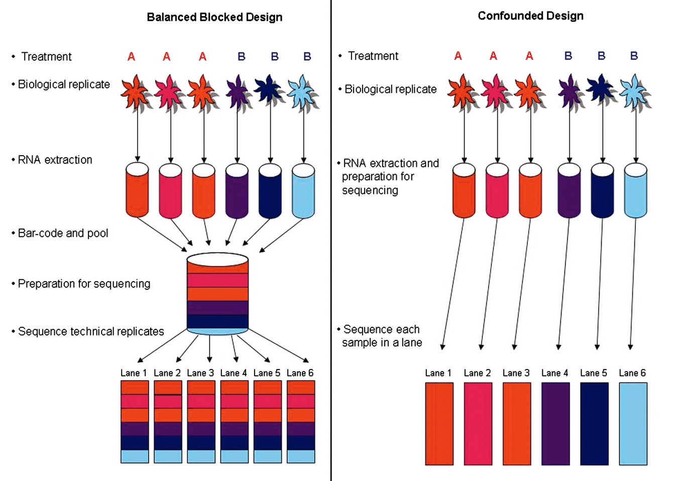
Avoiding bias by pooling samples

